Slide 1
Benefits Claims Decision Support System Date: 2/01/16 PM: Elizabeth Wollin
Schedule | Staffing | Funding | Integration | Stakeholder Comms | VBA Overall | OI&T Overall
 | ● | ● | N/A | ● | ● | ●
Cross Dependencies: N/A
Completed this Week:
Development of Presentation
Simplification of Presentation
Presentation on Wed 1/27
Meetings/working sessions
Meetings w/Elizabeth
Meetings w/Matthew, Paul and Edward
Overdue:
None
Due Next Week:
Working through Ear Model
Preliminary design diagrams - preparation for 2/26 presentation
Acquisition Package and CR Updates:

Slide 2
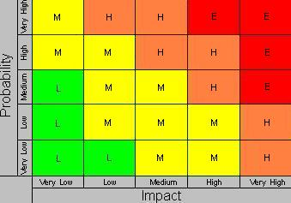
Benefits Claims Decision Support System Date: 12/11/15 PM: Elizabeth Wollin
Risk 1:
Title:
Risk: If delays in obtaining data.
Impact: The deliverables will be delayed.
Mitigation Steps to Date:
Regularly communicate timeline and data needs with VA PM.
Action Items:
VA PM working to obtain required agreements for data and data transfer.
Who: VA PM Due Date: Ongoing
Risk 2:
Title: Technical [12/11/15]
Risk: If expectations re: Mitre Scripts and Analysis duplication.
Impact: VA Stakeholder buy-in may not be obtained.
Mitigation Steps to Date:
Clearly Communication project approach and potential benefits with Business and Technical subject matter experts (SMEs).
Action Items:
Coordinates project meetings with Business and Technical SMEs.
Who: VA PM and Project Team Due Date: Ongoing
1
2

